Slide 1
EventMate: AI – Based Event Planner and Scheduler
EventMate is an intelligent event management platform designed to simplify the process of planning, organizing, and scheduling events. Traditional event management often involves challenges such as manual scheduling, tracking resources, sending timely reminders, and ensuring smooth coordination between participants.
Presented By :
Manisha
Ragavi
Sanjana
Ranjeetha M
Aagam Kasliwal

Slide 2




Project Description
Frontend (React)
Backend (Spring Boot)
Interactive UI for users to register, log in, create and manage events seamlessly
Manages business logic, user authentication, and database operations
Database (MySQL)
Build Tool (Maven)
Stores user information, events, and scheduling data securely
Handles dependency management and project build process
EventMate integrates a React-based frontend with a Spring Boot backend, providing a seamless and secure platform for both users and organizers. The system automates and optimizes the entire workflow, enabling users to create and manage events, schedule sessions, allocate resources, and send personalized notifications.

Slide 3

Frontend and Backend Architecture
React.js Frontend
The frontend leverages reusable components such as event cards, forms, and buttons, maintaining a consistent look and feel throughout the application.
Real-time updates without full page reloads
Seamless communication with backend APIs
Responsive design across all devices
Efficient data fetching and display

Slide 4
Project Objectives
01
02
Digital Event Management Platform
Simplify Event Creation & Scheduling
Create an online system where users can easily manage their events without relying on manual methods, reducing complexity and saving time.
Allow users to add, edit, and delete events with proper time and date management, ensuring structured planning and avoiding conflicts.
03
04
Secure Authentication & Data Handling
Reliable, Scalable Solution
Using JWT-based login and registration, guarantee that only authorized users can access their event data with privacy and security.
With React frontend and Spring Boot backend, deliver a responsive, interactive system capable of handling multiple users efficiently.

Slide 5




Key Features
User Registration & Authentication
Event Creation & Management
Secure signup and login for attendees and organizers with JWT-based token authentication
Organizers can create, update, and manage events with details like date, venue, and description
Event Booking & Ticketing
Search & Filters
Attendees can browse events, book tickets, and receive instant confirmations
Users can search events by category, date, or location and apply filters for easy navigation

Slide 6
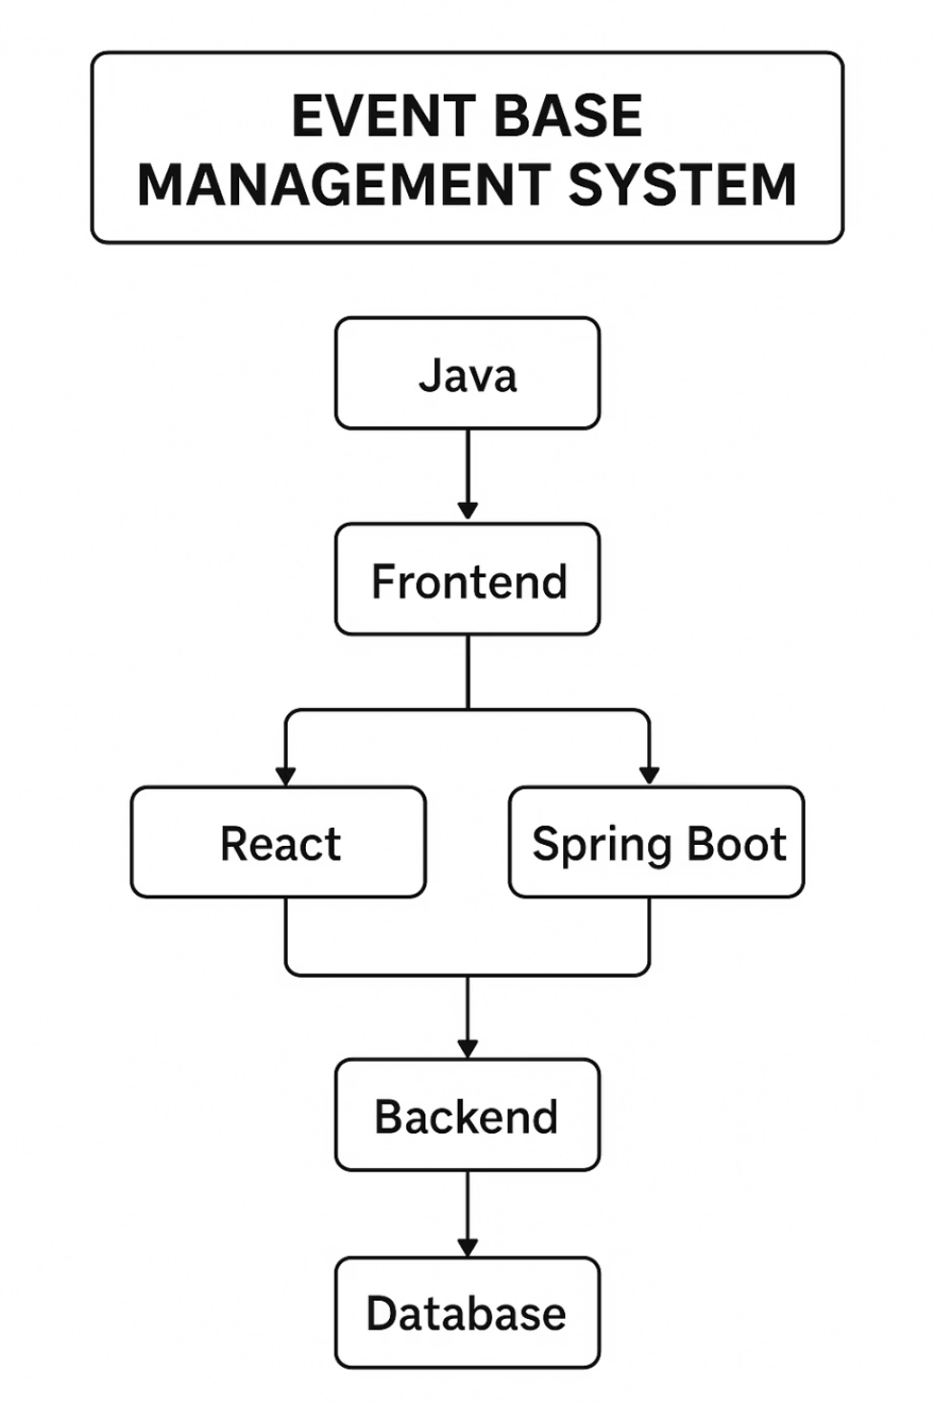
System Flow Chart
User Journey Flow
The flow chart illustrates the complete user journey through the EventMate platform, from initial registration to event management.
User registers or logs into the system
Authentication is verified via Spring Boot backend
User accesses dashboard to view or create events
Event data is stored and retrieved from MySQL database
Users can book, manage, or update event information

Slide 7
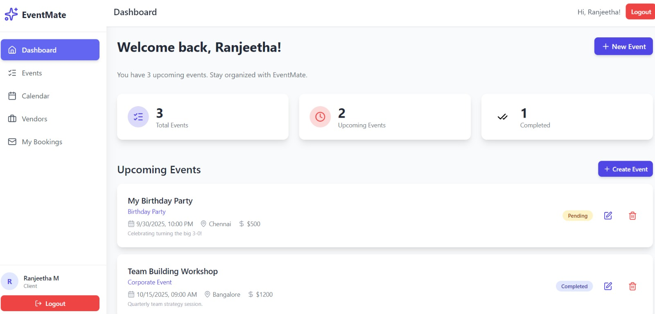



Client Interface
Intuitive Dashboard
Real-time Updates
Responsive Design
Clean, user-friendly interface for easy event browsing and ticket booking
Instant notifications and event changes displayed dynamically
Optimized experience across desktop, tablet, and mobile devices

Slide 8
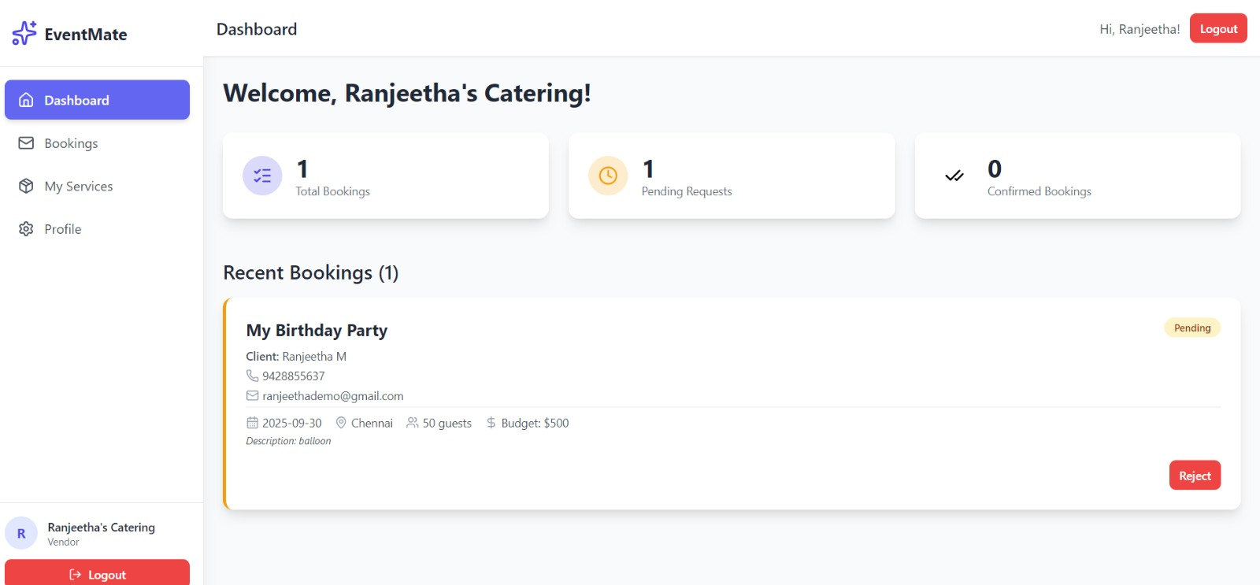
Vendor Interface
Create Events
Manage & Update
Track Performance
Add new events with comprehensive details and scheduling
Edit event information and manage attendee bookings
Monitor event metrics and attendee engagement

Slide 9
Spring Boot Database Integration
Configuration Setup
1
Database URL, username, and password configured in application.properties file
2
Entity Mapping
Each database table mapped to Java entity class with Spring Data JPA
Repository Layer
3
CRUD operations handled through repository interfaces
4
Request Processing
Controller receives frontend request, service layer processes business logic
Data Exchange
5
Repository interacts with MySQL database to fetch or update data
When the frontend sends a request, the controller receives it, and the service layer processes the business logic. The repository interacts with the database to fetch or update data, and the result is sent back through the service and controller to the frontend.

Slide 10
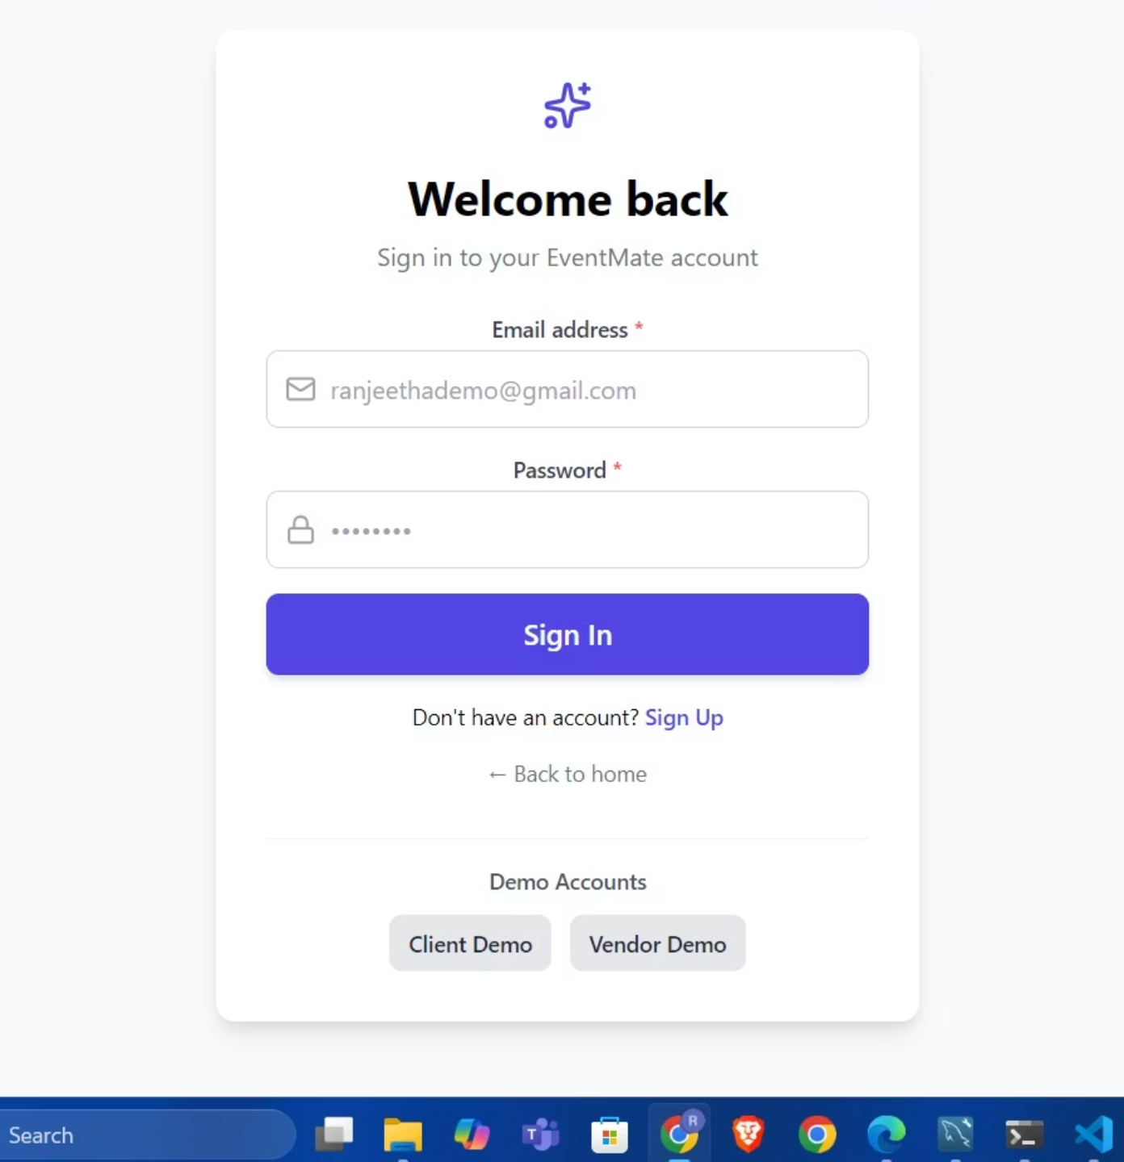

Authentication Flow
Secure Login Process
User enters credentials on React login page
Frontend sends API request to Spring Boot backend
Authentication controller forwards to service layer
UserRepository verifies credentials in MySQL database
Backend generates JWT token upon successful match
Frontend stores token securely and grants access
Security First: If credentials are invalid, an error message is returned instead, ensuring unauthorized users cannot access the platform.

Slide 11
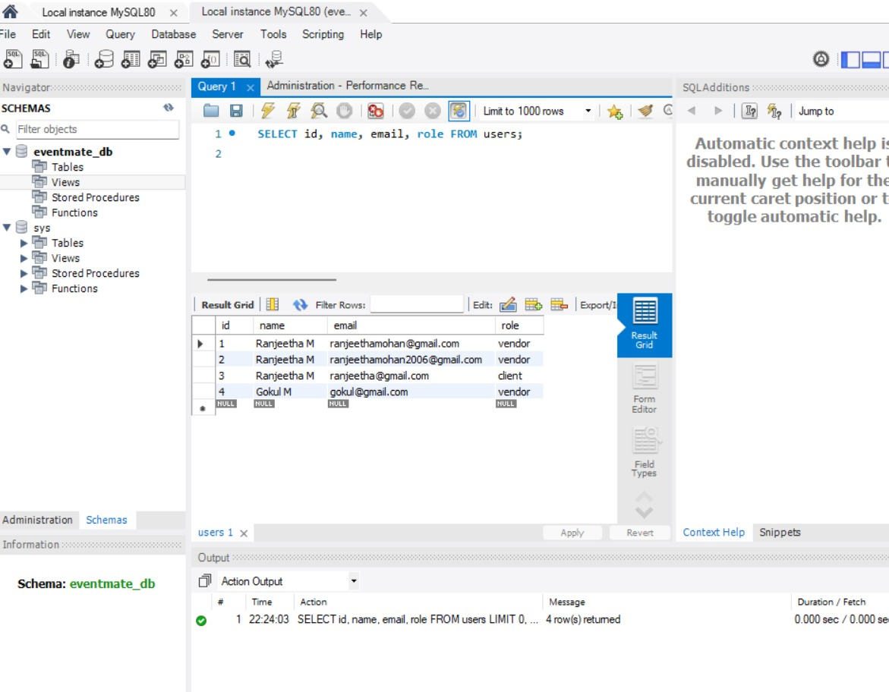
EventMate Database Architecture
A comprehensive exploration of EventMate's intelligent event planning system, powered by MySQL database architecture and AI-driven workflows that transform how users organize and manage events.

Slide 12






AI Processing Workflow
Phase 1: Rule-Based Intelligence
EventMate's AI system leverages pattern recognition, mathematical calculations, and keyword matching to deliver intelligent event suggestions in real-time.
User Input
Key Functions
Event details and preferences captured
getPersonalizedSuggestions()
Text Analysis
generateSuggestions()
Natural language processing extracts key information
Pattern Recognition
Pattern matching algorithms
Identifies event type and requirements
Real-time processing simulation
Context Understanding
Analyzes user preferences and constraints
Response Generation
Creates personalized suggestions
UI Display
Presents results seamlessly
Core Component
The AISuggestionsCard.jsx component serves as the intelligence hub, orchestrating user interactions and processing inputs to generate contextual event recommendations.

Slide 13

Smart Booking Workflow
01
02
Vendor Selection
Date & Time Selection
User browses and selects preferred vendor from curated list
Calendar interface for choosing event date and time slot
03
04
Availability Verification
Conflict Detection
Real-time database check confirms vendor availability
System identifies any scheduling overlaps or conflicts
05
06
Alternative Suggestions
Booking Confirmation
AI recommends suitable alternatives if conflicts exist
Finalize reservation and lock the time slot
Availability Check Algorithm
Objective
Process Flow
Verify vendor availability on selected date and time before confirming any booking to ensure seamless event planning.
User selects vendor and desired date/time
System queries vendor's booking database
Checks for overlapping slots using timestamp comparison
If slot is free → proceed to booking confirmation
If slot is occupied → trigger conflict detection and alternatives
Key Features
Real-time database verification with sub-second response
Optimized time complexity through indexed date queries
Concurrent request handling for multiple users

Slide 14
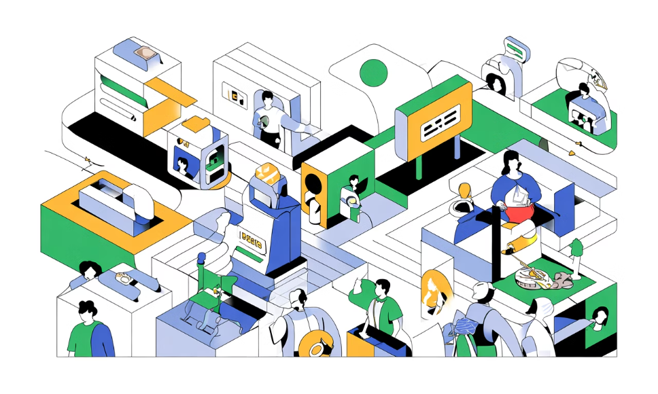
Smart Alternative Matching
Objective
Matching Criteria
Automatically suggest suitable alternative vendors when the preferred choice is unavailable, ensuring users always have quality options.
Category Similarity
Matches exact service type (e.g., catering, photography)
Location Proximity
Distance-based sorting prioritizes nearby vendors
Price Range
Within ±10% tolerance of original vendor pricing
Algorithmic Approach
Weighted scoring system ranks alternatives
Quality Metrics
Optional AI/ML model for personalized recommendations
Customer ratings and reliability scores factored in
Multi-factor analysis ensures best matches
Time Availability
Confirmed availability during requested window

Slide 15





Extended Workflow & Conflict Management
Data Collection
Vendor Filtering
Similarity Scoring
Gather user preferences: category, price range, ratings
threshold
Fetch vendor list meeting base criteria from database
Calculate weighted similarity scores for each candidate
Result Sorting
Quick Booking
Sort and present top 3–5 matches to user
Enable one-click booking for selected alternative
Conflict Detection Process
Objective
Workflow Steps
Identify and manage double-booking or overlapping time slots efficiently to maintain booking integrity across all vendors.
Every booking request runs through conflict check module
Compare requested time window against existing vendor bookings
Detection Logic
Detect overlaps using interval comparison algorithm
The system uses interval comparison logic to detect overlaps:
If conflict exists → notify user and invoke alternative matching
If no conflict → confirm booking and lock time slot immediately
if (start1 < end2 && start2 < end1) { conflict = true;}
System Highlights
Prevents double-booking errors automatically
Maintains booking integrity across all vendors
Logs conflict data for analytics and continuous improvement

Slide 16
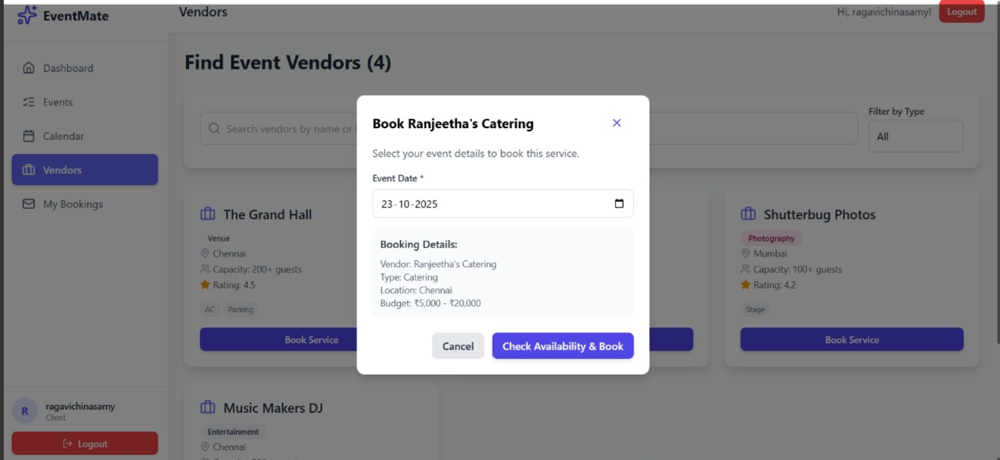
User Booking
The intuitive dashboard guides users through vendor discovery, availability checking, and booking confirmation with a clean, responsive interface that adapts to any device.

Slide 17
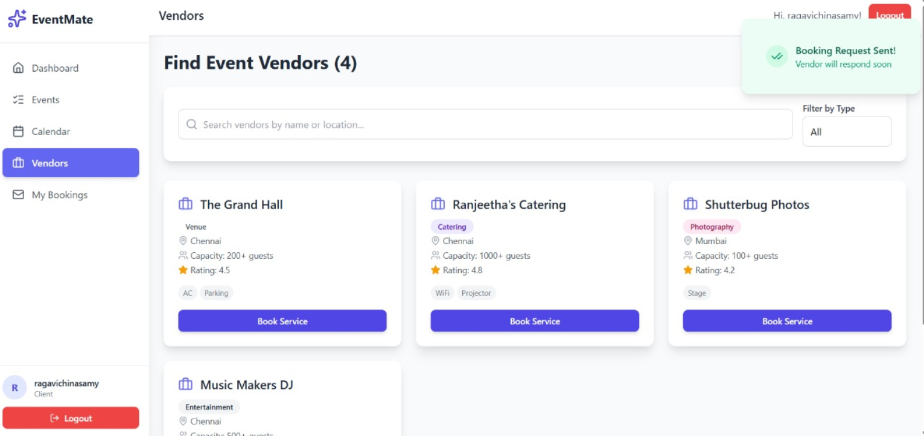
Vendor Management Interface
Comprehensive vendor profiles display ratings, availability calendars, service offerings, and pricing—empowering users to make informed decisions quickly and confidently.

Slide 18
Conclusion
Delivering Excellence
Modern Technology Stack
EventMate provides a reliable and user-friendly platform for managing events by seamlessly integrating React frontend, Spring Boot backend, and MySQL database.
The project demonstrates how modern technologies combine to deliver a scalable, practical solution for personal, academic, and professional event management.
1
2
3
Future Enhancement: Calendar
Integration
Future Enhancement: Mobile
Support
Future Enhancement: Advanced
Analytics
Sync with Google Calendar, Outlook, and other platforms for seamless scheduling
Native iOS and Android apps for on-the-go event management
Insights dashboard showing booking trends and vendor performance metrics
EventMate transforms event planning from a complex challenge into an intuitive, intelligent experience—powered by AI, backed by
robust architecture, and designed for success.

